Slide 1
Die Reconstruction and High-Density Interconnects for Embedded Chips
Neuralink, US 2024/0128222 A1, Published 4/18/2024
6/17/2024

Slide 2
Background
Implantable devices can be implanted into neurological tissue
Bio-compatible substrate with electrodes for recording or stimulating neuronal signals
Neuronal signals require analog-to-digital conversion, aggregation, and conversion to data packets or to human/machine-readable formats → require electronics occupying significant volume & adding significant weight to brain implant
Need lightweight, compact electronics package for BCIs

Slide 3
Outline
Goal: Describe a method for manufacturing a sealed electrical device with “bare die” IC chip embedded within pocket of substrate & fabricated interface with direct electrical connections to IC chip
Purpose: To decrease the volume for better integration of the implant system in brain & ensuring IC chip and interface are hermetically sealed & interconnected
Embodiments:
Vertical cross-section of sealed electrical device with embedded IC chip
Vertical cross-section of sealed electrical device with embedded IC chip + housing
Flowchart for manufacturing a sealed electrical device
Flowchart for chip-first process for manufacturing a sealed electrical device
Flowchart for chip-last process for manufacturing a sealed electrical device

Slide 4
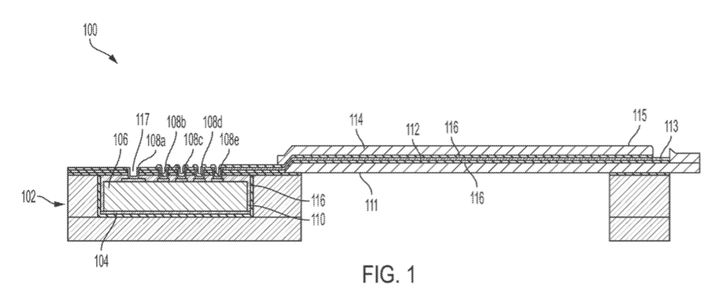


Vertical cross-section of sealed electrical device with embedded IC chip
- Sealed via hermetic coating
- Greater # of IC chips + conductive traces incorporated within implant
- Sealed electrical device – 30x density of typical IC chip
Conductive traces
Patterned onto polymer sheet
Include conductive polymers (PEDOT), conductive ceramics (doped diamonds), conductive metals (gold, platinum), conductive metal-oxides (iridium oxide)
Connection pads
(facing outward – away from pocket)
Ribbon cable
(formed from polymer-coated conductive traces)
Vias
Casing
Electrodes
Bare Die IC Chip
(embedded in pocket of substrate)
Substrate
(single-crystal substrate of silicon or gallium nitride)
Polymer sheet
Hermetic coating
Hermetically seal electrical device
Applied to substrate before IC chip placed into pocket
Deposited over IC chip (to seal IC chip), conductive traces
Exposed at the site of implanted electrodes
e.g., silicon carbide, silicon oxide, hafnium oxide, diamond
Filler
(fill gaps between IC chip and pocket)
Pocket
(substrate with material removed)

Slide 5
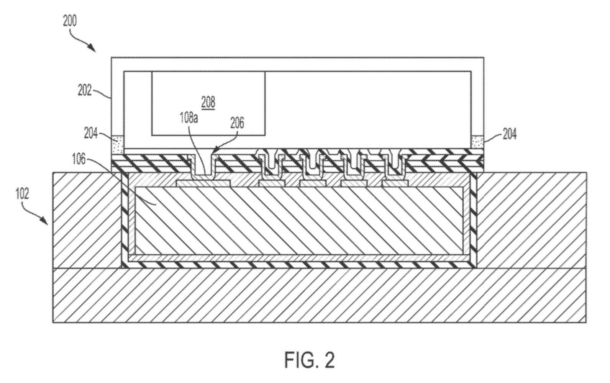

Vertical cross-section of sealed electrical device with embedded IC chip + housing
Unsealed connection pad
(e.g., power input pin)
Housing
(mounted on metal ring; enclose + seal IC chip; may be cap or lid)
Circuit board
Power input pin
Connect to components in housing to power sealed electrical device
Connect to circuit board
Include VCC (voltage > ground)
Metal ring
(formed around perimeter of pocket)
Metal ring
IC Chip
Substrate

Slide 6
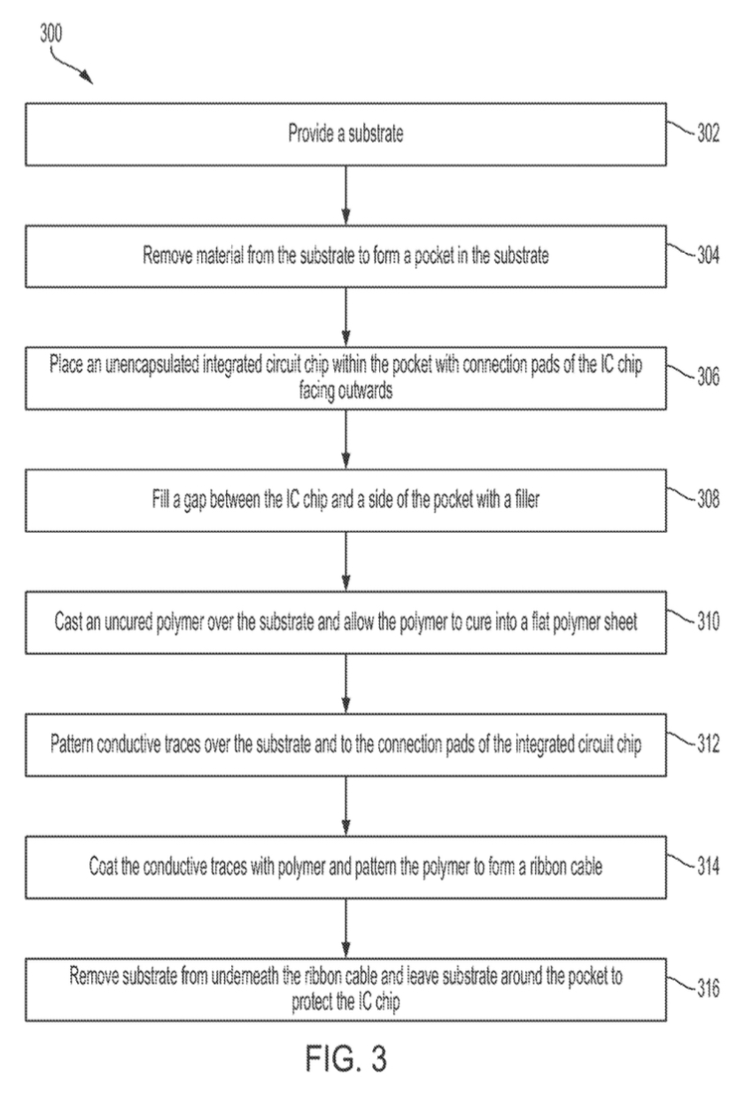
Flowchart for manufacturing a sealed electrical device

Slide 7

Step 1:
Substrate
(silicon wafer, glass wafer, polymer panel, or ceramic plate)

Slide 8


Step 2:
Hermetic coating
(e.g., atomic layer decomposition of hafnium oxide, or chemical vapor decomposition of diamond)
Pocket
(etched or milled to accommodate IC chip)

Slide 9
Step 3:
Bond pads
IC chip

Slide 10
Step 4:
Filler
(polymer)

Slide 11
Step 5:
Flat polymer sheet

Slide 12
Step 6:
Hermetic coating
Conductive traces

Slide 13

Step 7:
Ribbon cable
(patterned polymer)
Electrode

Slide 14
Step 8:
Housing
Circuit board
Metal Ring
Power input pin
Substrate removed under ribbon cable

Slide 15
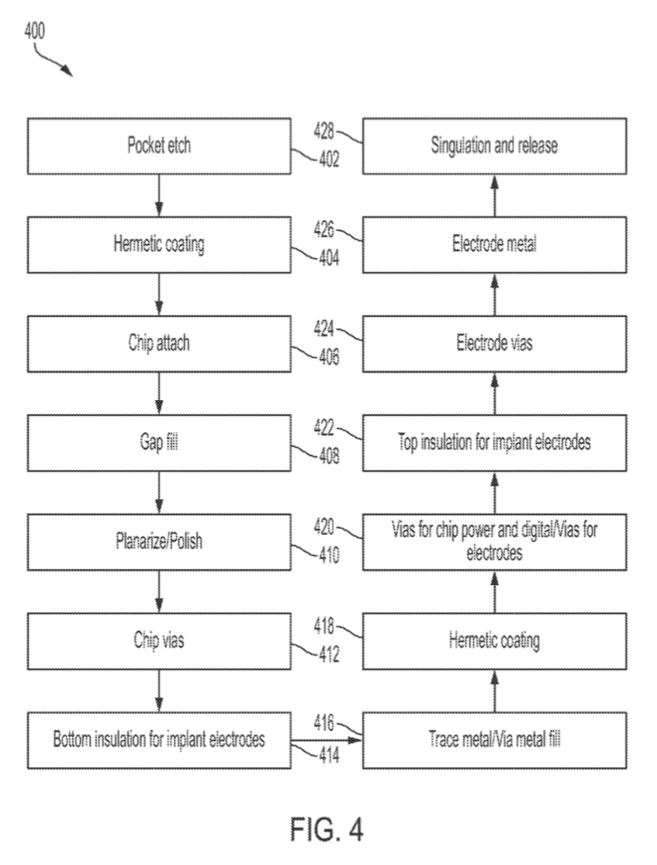
Flowchart for chip-first process for manufacturing a sealed electrical device

Slide 16

Step 1:

Slide 17
Step 2:

Slide 18

Step 3:

Slide 19
Step 4:

Slide 20
Step 5:
Planarized/polished filler

Slide 21

Step 6:
Etched vias

Slide 22
Step 7:
Bottom insulation layer

Slide 23
Step 8:
Trace metal

Slide 24
Step 9:
Hermetic Coating

Slide 25
Step 10:
Vias (via etched hermetic coating)

Slide 26
Step 11:
Top insulation layer

Slide 27
Step 12:
Vias etched into insulation layer

Slide 28
Step 13:
Electrode metal

Slide 29

Step 14:
Singulation (cutting)

Slide 30
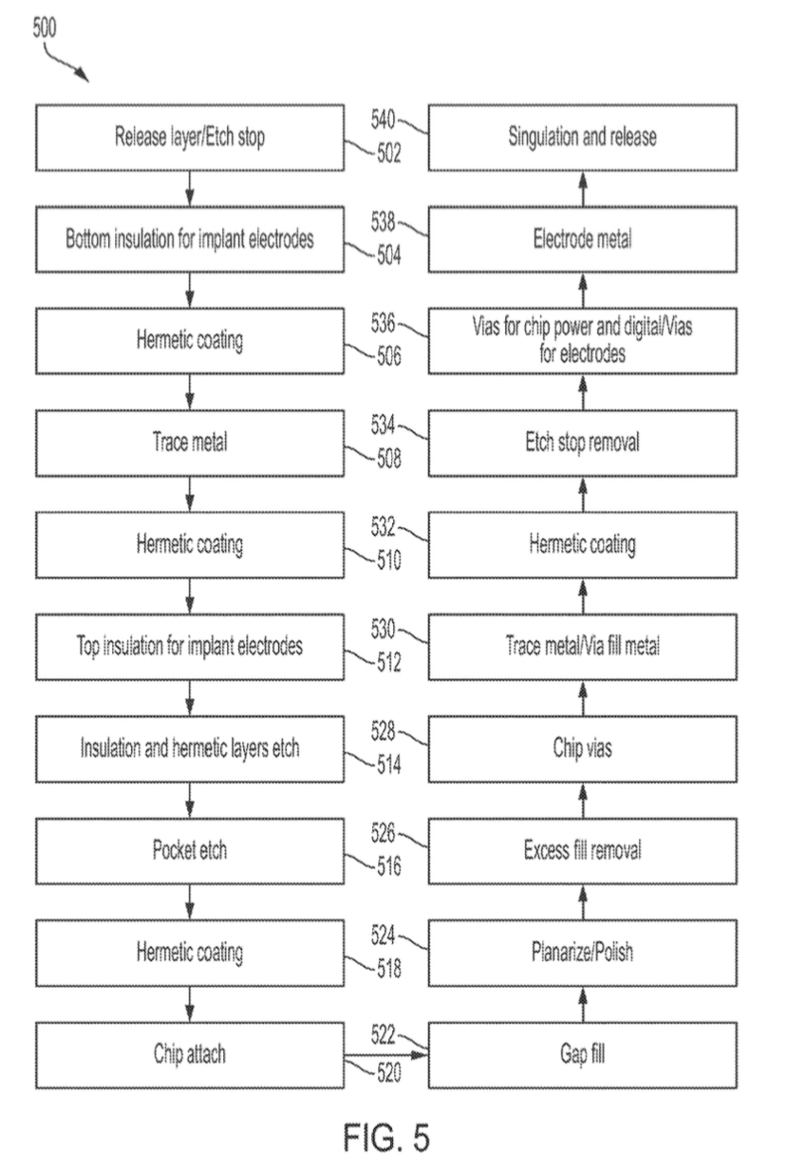
Flowchart for chip-last process for manufacturing a sealed electrical device

Slide 31
Step 1:
Etch stop

Slide 32
Step 2:
Bottom insulation layer

Slide 33
Step 3:
Hermetic Coating

Slide 34
Step 4:
Conductive trace

Slide 35
Step 5:
Hermetic Coating

Slide 36
Step 6:
Top insulation layer

Slide 37
Step 7:

Slide 38
Step 8:

Slide 39
Step 9:
Hermetic coating

Slide 40

Step 10:
IC Chip

Slide 41
Step 11:
Filler

Slide 42
Step 12:
Filler planarized/polished

Slide 43
Step 13:
Excess fill removed

Slide 44
Step 14:
Filler etched in connection pads

Slide 45
Step 15:
Conductive trace

Slide 46
Step 16:
Hermetic coating

Slide 47


Step 17:
Etch stop
Etch stop

Slide 48
Step 18:
Hermetic coating etched
Hermetic coating etched

Slide 49
Step 19:
Electrode metal

Slide 50
Step 20:
Singulation (cutting)

